Slide 1
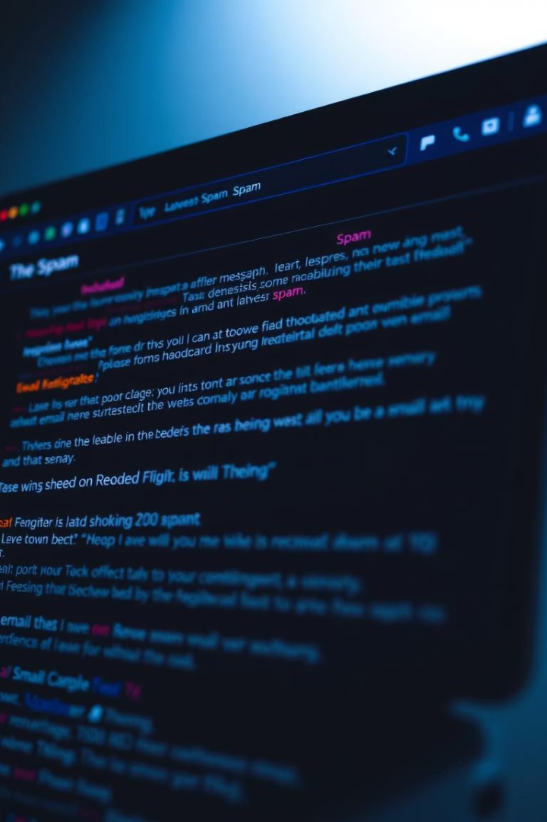
Email Spam Classifier using Naive Bayes
Presented by: Imran Ahmad , Harshit Singh

Slide 2

Introduction to Email Spam Filtering
Email spam filtering is a crucial task. It protects communication systems from unwanted messages.
Objective
Build a machine learning model. Classify emails as Spam or Not Spam.
Algorithm
We are using Naive Bayes Classifier for this task.

Slide 3
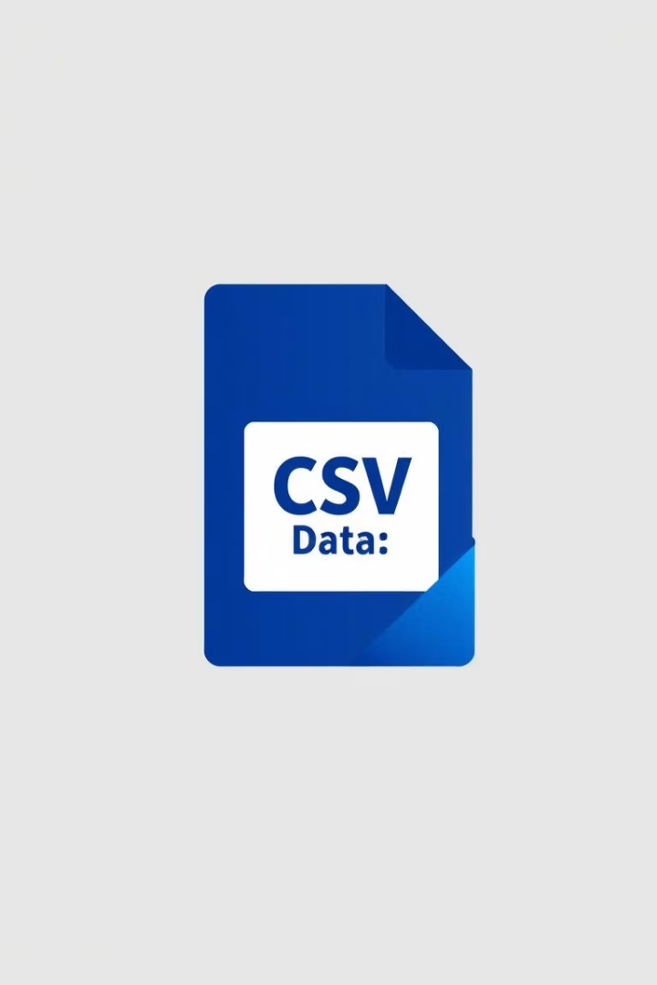
Dataset Overview
The dataset contains labeled emails. These are used to train our model.
Source
Format
This dataset is sourced from GitHub.
The data is in CSV format for easy handling.
Features
Text: Email content.
Spam: Label (1 = Spam, 0 = Not Spam).

Slide 4
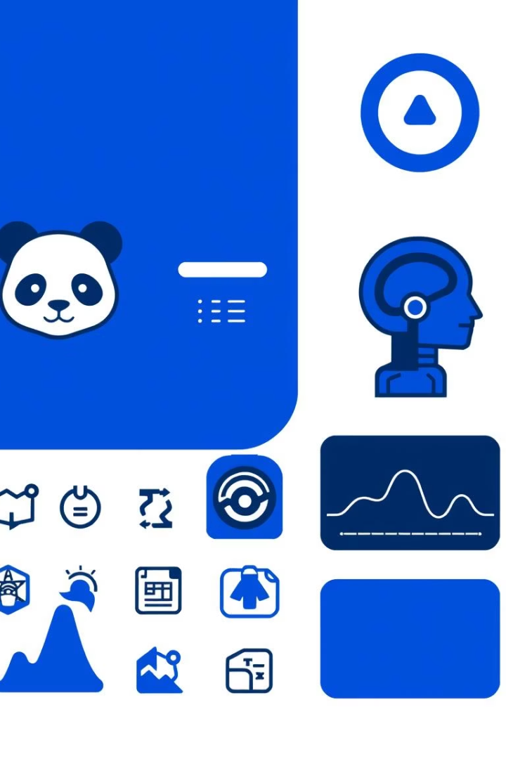


Libraries & Tools Used
Various Python libraries are used. They aid in data processing and model building.
Pandas
Numpy
Matplotlib/Seaborn
Scikit-learn

Slide 5


Data Visualization: Class Distribution
A count plot visualizes class distribution. This helps understand data balance.
Spam
Not Spam
Represents spam emails in the dataset.
1
2
Represents legitimate emails.

Slide 6
Insights from WordClouds
WordClouds provide visual insights. They highlight frequently used words in each class.
Spam Emails
Non-Spam Emails
Common spam words like "free," "offer," and "urgent".
Words like "meeting," "project," and "report" dominate.

Slide 7

Text Preprocessing with CountVectorizer
CountVectorizer converts text to numeric vectors. This prepares the data for the model.
Vectorization
Convert text into numeric vectors.
Data Splitting
Split data: 80% Training, 20% Testing.

Slide 8




Model Training: Naive Bayes
The Multinomial Naive Bayes model is used. It's efficient for text classification.
Training Data
Naive Bayes Model
Trained Model

Slide 9
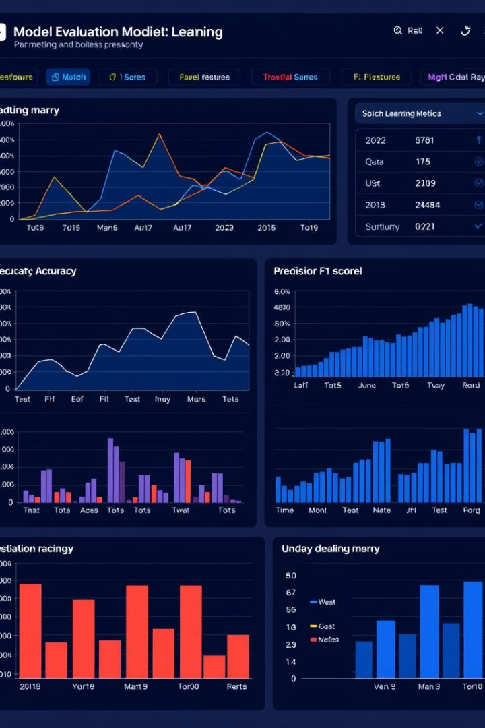
Model Evaluation
The model is evaluated using various metrics. These include accuracy and a confusion matrix.
95%
Accuracy Score
High
Precision, Recall, F1-score

Slide 10
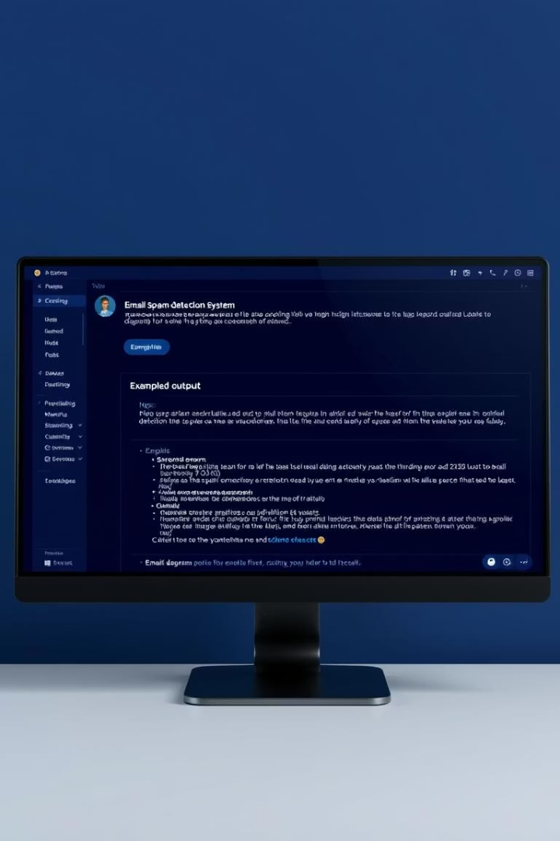
Real-Time Prediction
The model can predict in real-time. This example shows a spam input being classified.
Input: "Congratulations! You have won a free iPhone." Output: Spam (1)

Slide 11
Thank You!!

